Slide 1

RRED to Counter LDoS
- 1705045

Slide 2
Specification
Reference
LDoS Attack: Sends short packet-burst (T_{b}) with a large period (T_{a}) at high data rate (R_{b}) .
Implementing RRED in NS3.
Testing LDoS without and without RRED.
RRED = Attack packet filtering + Usual RED.

Slide 3
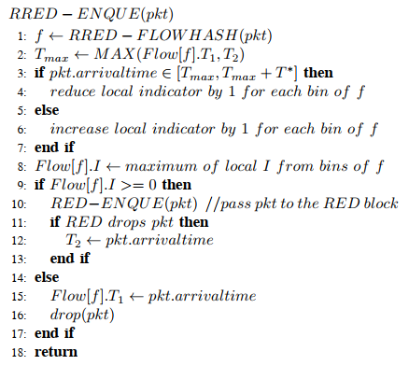
RRED Algorithm
Uses bloom-filtering for too many packets/flows.
L levels, N bins.

Slide 4
Implementing RRED in NS3
Already implemented class: RedQueueDisc. It has option to enable ARED, Feng’s Adaptive RED, NLRED.
New attribute to be added in this class –
Enable for RRED.(boolean).
T* (double).
L and N (integers).
One 2D integer array for bloom-filtering (size [L][N]).
Integer T1 for each hash and integer T2.
Add function flow_hashing(packet) based on source-destination address pair.
Modify function RedQueueDisc::DoEnqueue().
Incorporate RRED_enqueue(pkt) at the beginning.
Use Boolean value retval (line 435) to update T2.

Slide 5
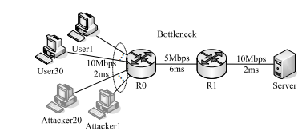
LDoS Attack
A network with many transmitting TCP packets with a server.
Generate LDoS traffic from attacker by sending UDP packets.
Vary T_{a}, T_{b}, R_{b} taking in command-line arguments.

Slide 6
THANK YOU

